Slide 1


Slide 2
Asia Akter Srabanty
Assistant Teacher (English)
Brahmondi Advocate Suruj Ali High School
Introduction
Subject : English For Today
Class : Eight
Unit : One
Lesson : one

Slide 3
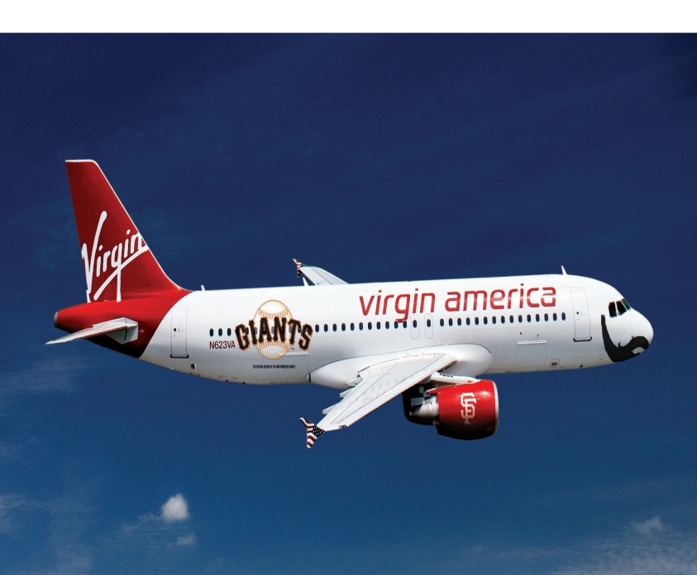
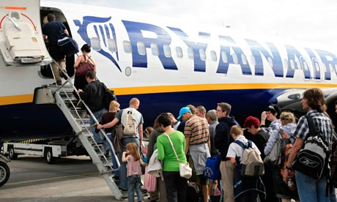
At the Airport

Slide 4
Learning outcome
By the end of the lesson students will be able to
read and give answers to some questions (reading skill)
ask and answer questions (Speaking skill)
write short composition. (Writing skills)
Use new words: Lounge, Immigration

Slide 5
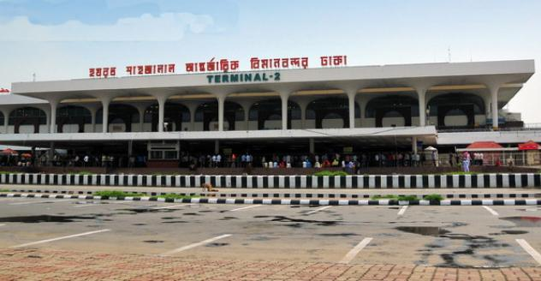
Hazrat Sahajalaj International Airport Dhaka

Slide 6
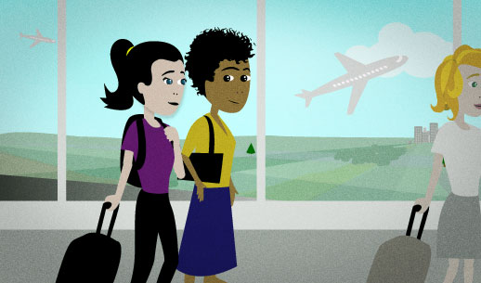

Slide 7
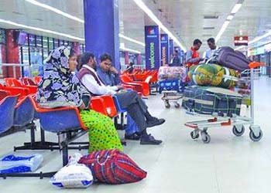
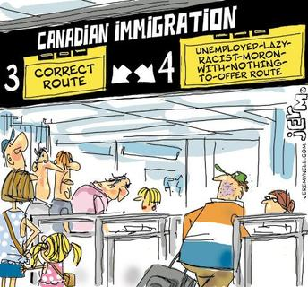
Lounge
A waiting room
Passengers are waiting at the airport lounge to board a plane.
Immigration
Passport & visa checking office
Passengers get ready for going through immigration with immigration form.

Slide 8
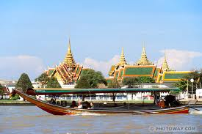
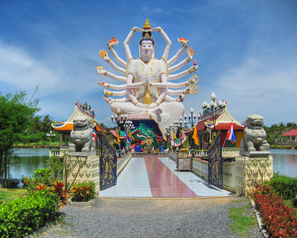
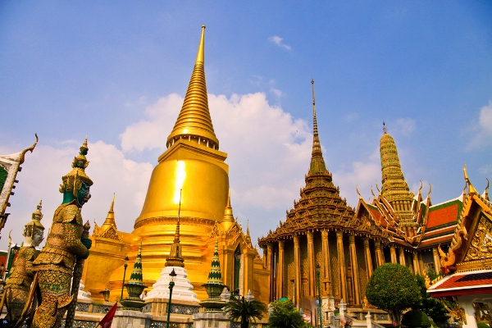
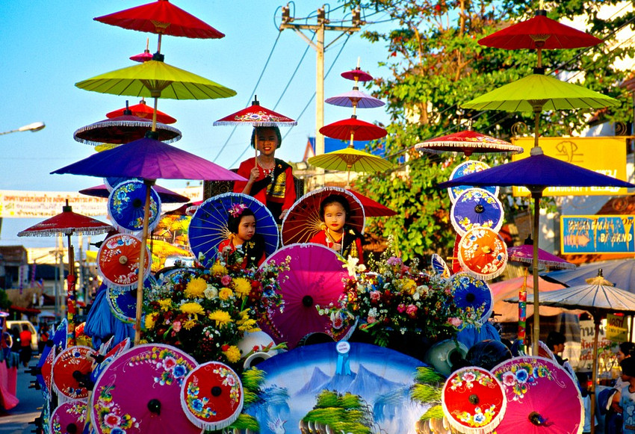
Beauty of Thailand

Slide 9
Read the text and find the answers of the following questions
Why is Mita excited?
2. Why aren’t Mita’s parents going with her?
3. What does an immigration officer do at the
airport?

Slide 10
Pair Work
Now play the role of passengers and ask and
answer some question about immigration process.

Slide 11
Homework
Write a short composition about your experience of travelling to another place.

Slide 12

Thank you

